Slide 1
Cloud computing
-Velocity Training institute -shantanu Mahajan (Sr. Engg Devops)

Slide 2
What is cloud computing?
Simply put, cloud computing is the delivery of computing services—including servers, storage, databases, networking, software, analytics, and intelligence—over the Internet (“the cloud”) to offer faster innovation, flexible resources, and economies of scale.
You typically pay only for cloud services you use, helping lower your operating costs, run your infrastructure more efficiently and scale as your business needs change.

Slide 3
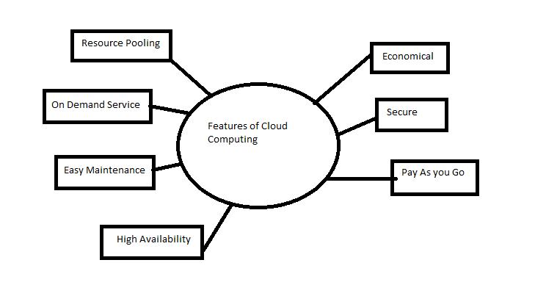
Features

Slide 4
Types of cloud
Private Cloud
Public Cloud
Hybrid Cloud

Slide 5
Private cloud
Private cloud is a cloud computing environment in which all hardware and software resources are dedicated exclusively to, or accessible by a single customer.
It’s a on-premises infrastructure.
Companies choose private cloud because their workload deals with confidential documents, financial data etc.
Private cloud is a single-tenant environment, meaning all resources are accessible to one customer only—this is referred to as isolated access. Private clouds are typically hosted on-premises in the customer's data center.

Slide 6
ADVANTAGES/disadvantages
Full control of hardware and software choices.
Freedom to customize hardware and software in any way.
Greater visibility into security and access control as workload is behind customers firewall.
Higher cost of installing hardware/software
Infrastructure management cost is high
Limited flexibility.

Slide 7
Public Cloud
Public cloud is a multi-tenant cloud environment, where the same computing resources are shared among multiple customers—sometimes hundreds or thousands of them.
In public cloud, an independent cloud services provider owns and maintains the infrastructure, and access to resources is offered on a subscription basis or via pay-per-use pricing.
Customer doesn’t have to maintain any hardware and no need for DC management.

Slide 8
Advantages/disadvantages
Greater elasticity and scalability: With public cloud, a customer can add capacity in response to unexpended surges in traffic, without purchasing and installing new hardware.
Lower cost of entry: Most customers can begin using public cloud services without adding physical compute resources of their own.
Faster access to the latest technologies: In many cases, economies of scale enable cloud providers to offer the latest hardware and software faster than customers could if they had to purchase and install them themselves.
Only Disadvantage could be that overall control over the hardware is not there, may be in some cases security can be an issue.

Slide 9
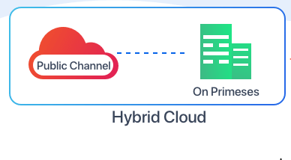
Hybrid cloud
A hybrid cloud integrates public and private cloud infrastructures. In this model, the two types of cloud are joined together into a single, flexible infrastructure, and the enterprise can choose the optimal cloud environment for each individual application or workload.
In simple words infra is shared in between your local data center and public cloud.

Slide 10
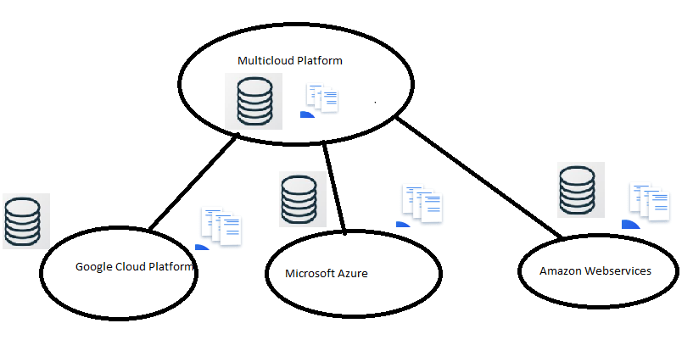
Multi-cloud
Here if you could see in the multi cloud architecture, some applications are deployed in AWS others are deployed in Azure etc.
This is done in large organizations as per client requirements

Slide 11
Categories of cloud
SAAS (Software as a service):-
Here a particular software program is hosted as a service and the user doesn’t need to have any software technical knowledge to use that service
Eg:- Google Drive, Drop box etc.
2. PASS (Platform as a service):-
PASS or aPass (application platform as a service) is category of cloud computing service that enables customer to run a application.
The only major difference between SaaS and PaaS is that - SaaS provides access to the software over the internet while PaaS provides a platform for software development
Eg:- Github, Blue max

Slide 12
IAAS (infrastructure as a service)
This as the name suggest, this is a service where the software infra such as physical servers, RAM, CPU etc. is provided as a service to the customer as per their requirement.
Mostly used by companies to run their day to day operations.
Hence, unlike SaaS and PaaS, IaaS is a whole virtualization technology where clients have access to the whole infrastructure through an API or dashboard.
Eg:- AWS, Azure, GCP

